Slide 1


Summit Feature
Presented By : The Mahsa Innovators
Poon Yong Hao | Ummu

Slide 2

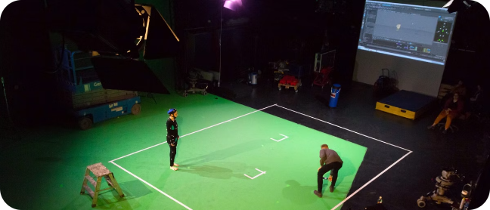

Introduction Summit Feature
Summit Feature is a leading motion capture company specializing in cutting-edge technology and innovative solutions for film, gaming, and entertainment industries. With our expertise, we aim to revolutionize the way motion capture is used to create immersive and realistic experiences.

Slide 3

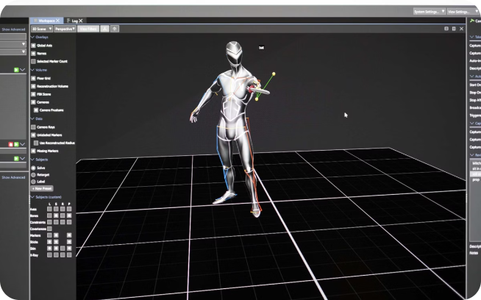
Understanding Motion Capture Technology
1
Capturing Movement
Motion capture uses sensors and cameras to record an actor's movements in real-time.
2
Data Conversion
The captured data is then converted into digital 3D models, replicating the actor's performance.
3
Applying to Digital Characters
The digital models can be used to animate characters in video games, films, and other digital media.

Slide 4
Benefits and Applications of Motion Capture
Increased Realism
Cost-Effective Solutions
Diverse Applications
Motion capture creates incredibly lifelike animations, enhancing the realism of digital characters and storytelling.
Motion capture technology offers a more efficient and cost-effective alternative to traditional animation techniques.
Motion capture has a wide range of applications, including film, gaming, sports analysis, healthcare, and virtual reality.

Slide 5

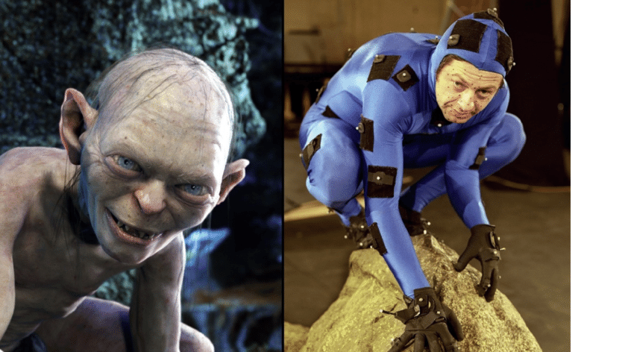

Motion Capture in Entertainment
Motion capture technology breathed life into iconic characters like Gollum and Thanos
Performance Captured
Digital Puppets Built
Emotional Nuance Captured

Slide 6

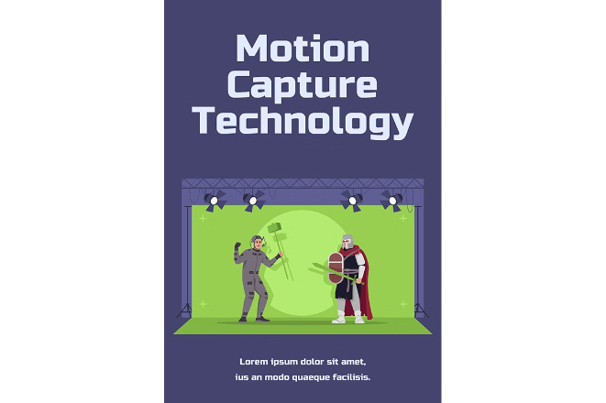
Educating the Public:
Awareness Campaigns
1
Engaging Content
Develop educational videos, articles, and social media content explaining the technology and its benefits.
2
Public Demonstrations
Organize live demonstrations at events and festivals to showcase motion capture in action.
3
Interactive Exhibits
Create interactive exhibits at museums and science centers to allow visitors to experience motion capture firsthand.
4
School Programs
Partner with schools and educational institutions to introduce students to motion capture technology.

Slide 7

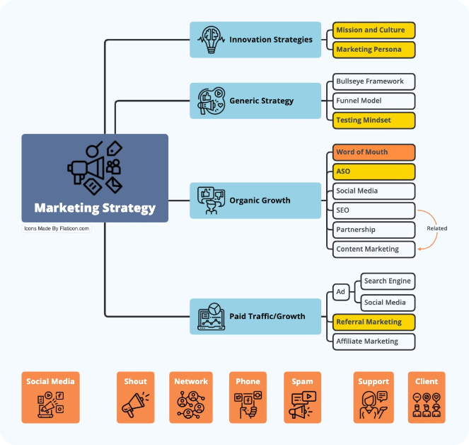
Reaching Target Audiences: Marketing Strategies
Targeted Advertising
Reach specific audiences through online advertising platforms, focusing on gaming, film, and technology communities.
Industry Events
Attend industry conferences and trade shows to network and promote Summit Feature's services.
Public Relations
Develop press releases and media campaigns to highlight Summit Feature's expertise and innovative projects.
Social Media Engagement
Utilize social media platforms to share engaging content, behind-the-scenes glimpses, and industry insights.

Slide 8





Collaborating with Industry Partners
Film Studios
Game Developers
Animation Studios
VR/AR Companies
Technology Research Institutions
Educational Institutions

Slide 9


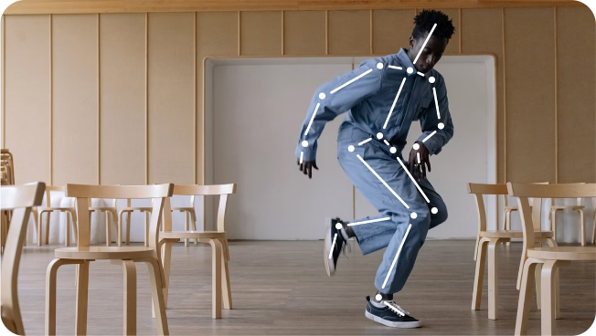


Driving Motion Capture Adoption
Education & Awareness
Educating the public about the capabilities and benefits of motion capture technology.
Marketing & Promotion
Reaching target audiences and showcasing Summit Feature's expertise through various marketing strategies.
Industry Partnerships
Collaborating with industry partners to drive innovation and expand the use of motion capture.

Slide 10

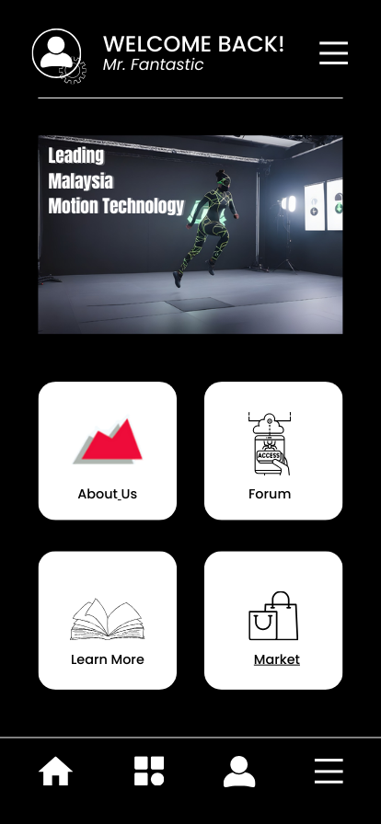
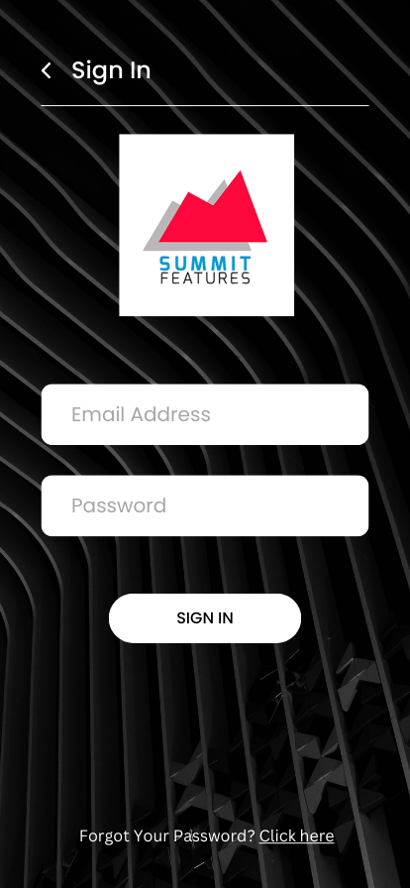
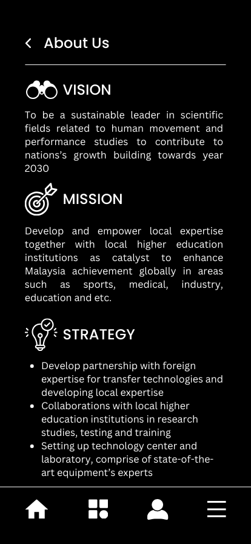
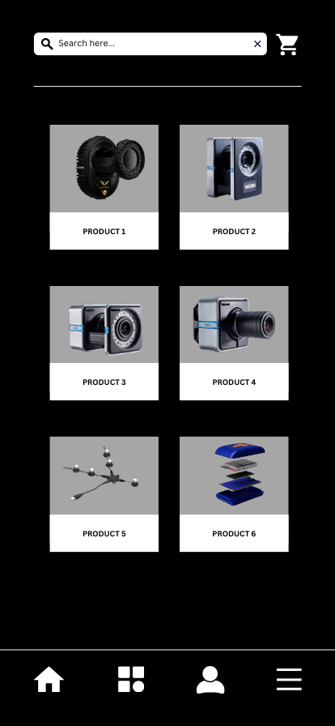
Prototype Introduction

Slide 11
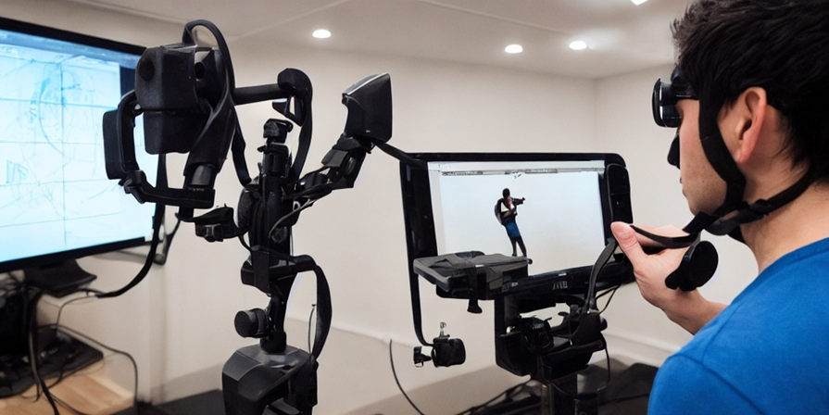
Conclusion
Summit Features Sdn Bhd appears to be a well-established Malaysian company in the biomechanics and human performance field. While their website lacks specific details on client experiences and projects, they claim to be a leading provider of motion capture technology and related services. If you're interested in learning more about their expertise and achievements, consider reaching out to them directly or exploring resources from Vicon, a company whose systems they distribute.

Slide 12

Thank you for Watching

